Slide 1

NEXTHIKES IT SOLUTIONS
Project 4: Feature Extraction and Price Prediction for Mobile Phones
~ Hasan Ahmed Khan

Slide 2
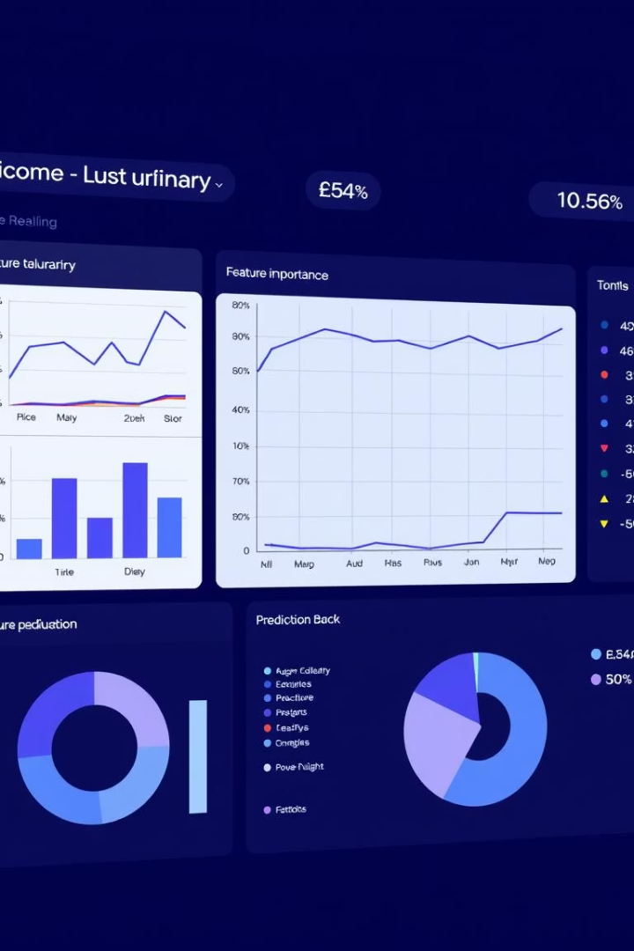
Model Performance Metrics
Linear Regression
Ridge Regression
MAE: 3.65E13, RMSE: 1.08E14, R²: -8.39E19 (poor fit)
MAE: 2374.41, RMSE: 6468.70, R²: 0.6964 (good fit)
Random Forest
MAE: 1809.14, RMSE: 4568.79, R²: 0.8486 (best fit)

Slide 3

Top Influential Features
Front Camera MP
Battery Capacity
Highest impact on price (0.4379)
Moderate influence (0.0928)
Memory
Specific Models
Strong impact (0.0785)
Apple iPhone 14 Plus and Google Pixel 7 notable

Slide 4
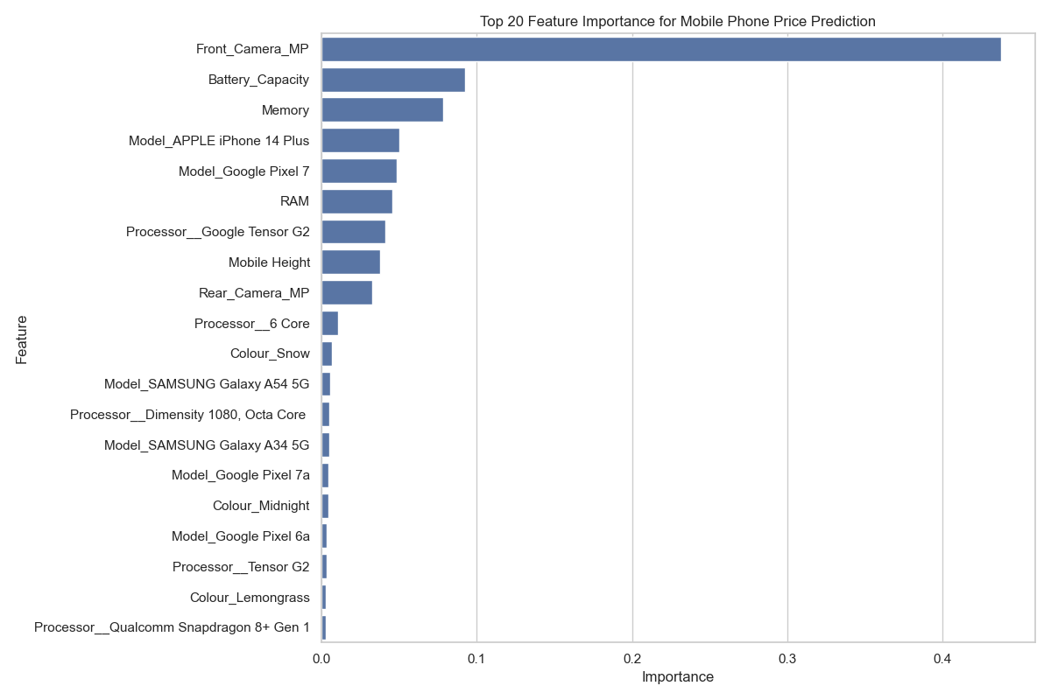

Slide 5

Additional Key Features
RAM
Important for pricing (0.0454)
Processor Types
Google Tensor G2 and 6 Core processors matter
Mobile Height
Small but notable effect (0.0376)
Rear Camera MP
Influences price moderately (0.0327)

Slide 6
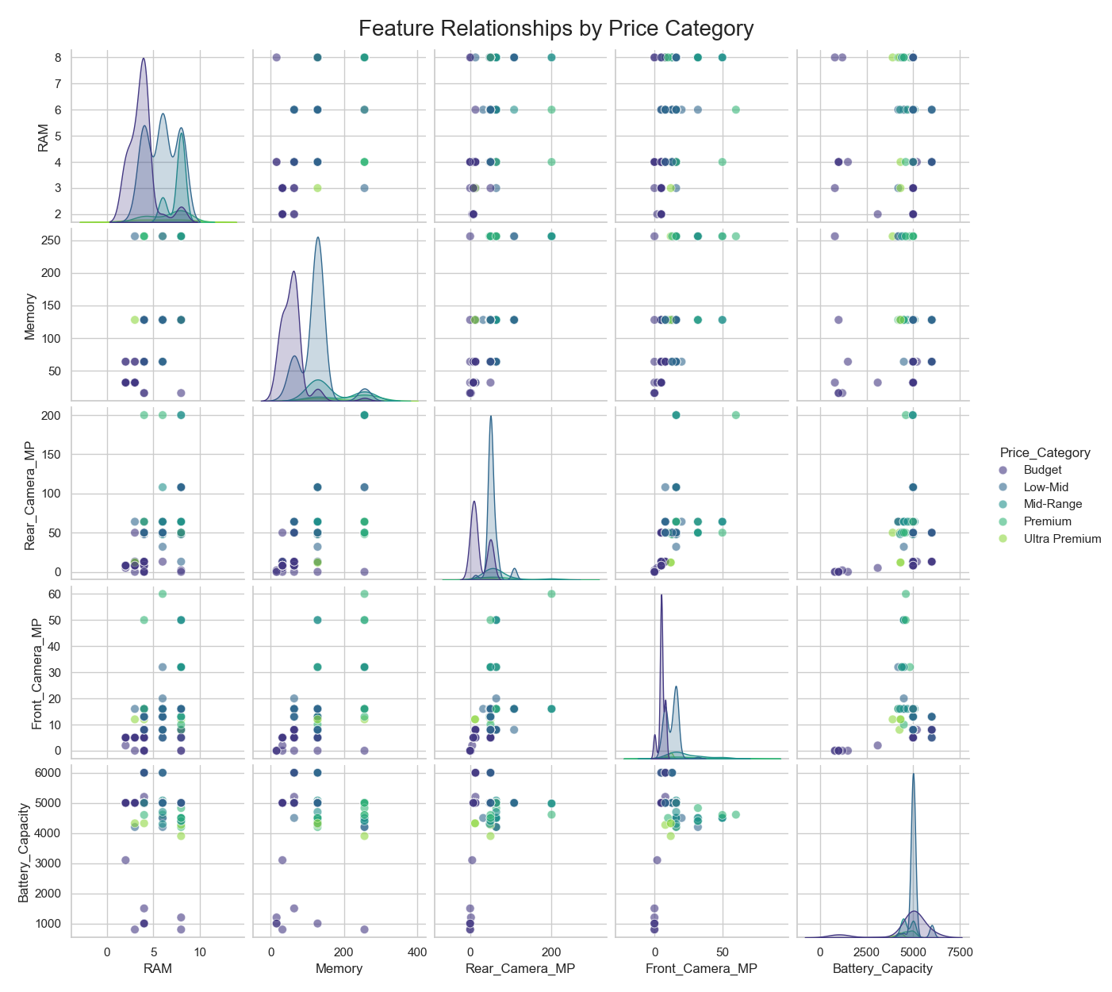

Slide 7
Feature Correlation with Price
Positive Correlations
Negative Correlations
Memory (0.5667)
Battery Capacity (-0.0343)
Front Camera MP (0.5323)
AI Lens (-0.1537)
RAM (0.5320)
Rear Camera MP (0.4104)
Mobile Height (0.1760)

Slide 8
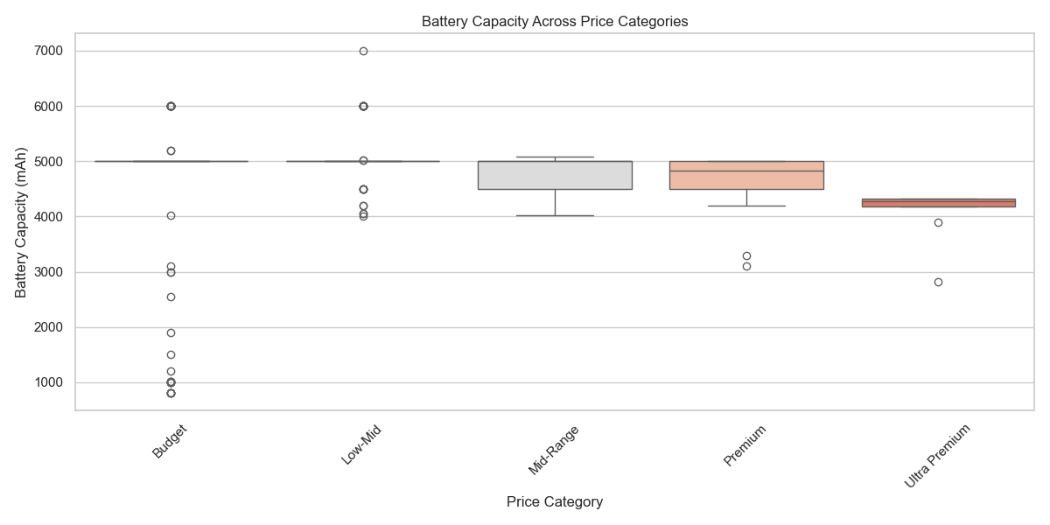
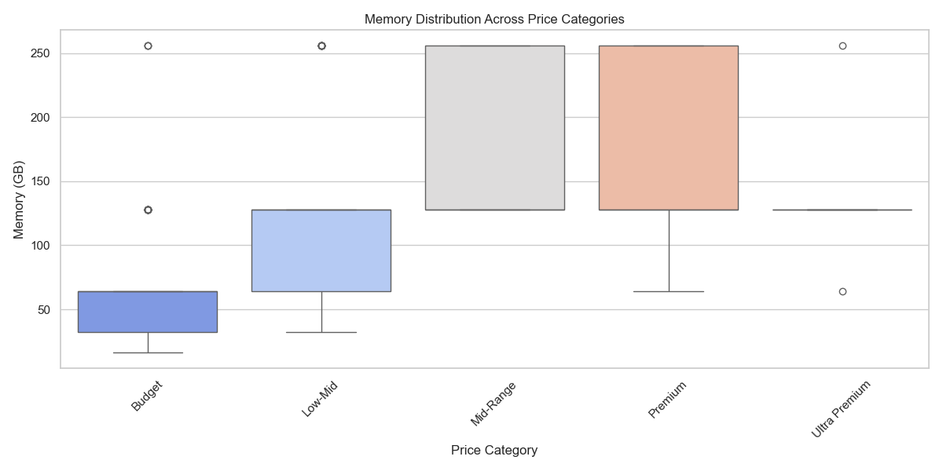
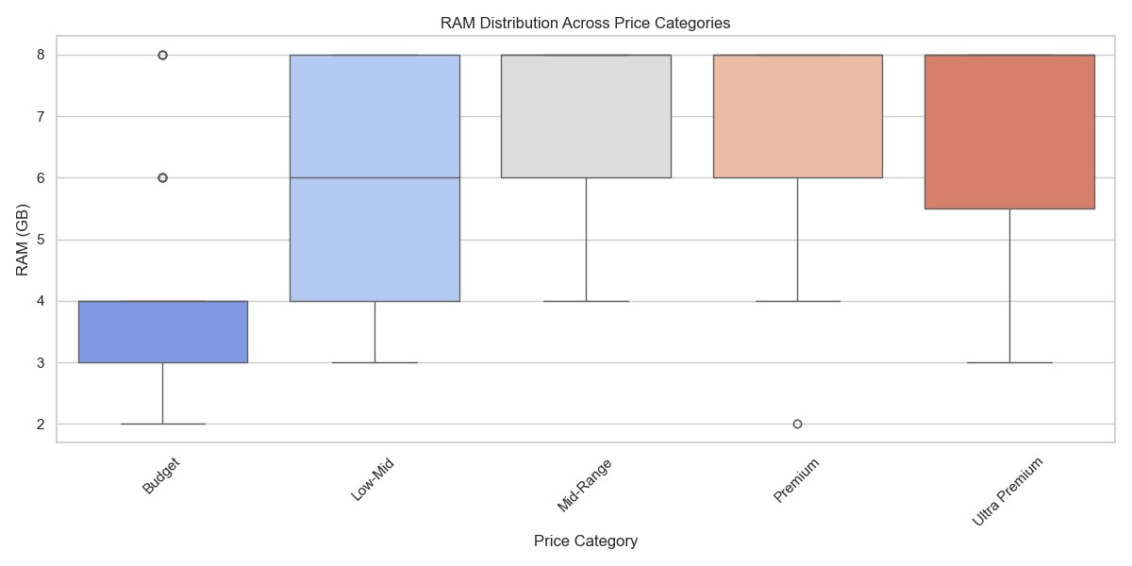

Slide 9
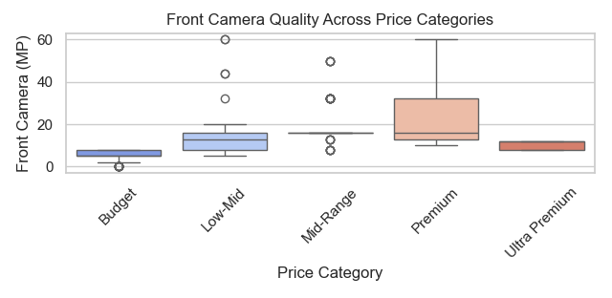
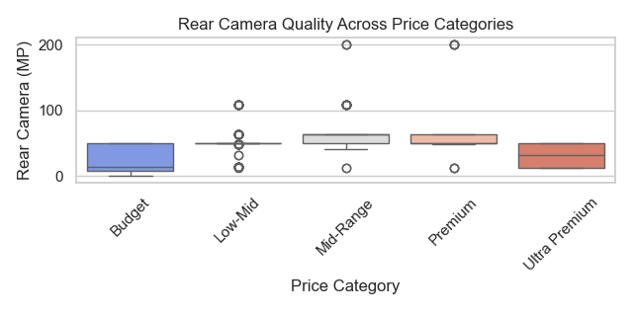

Slide 10
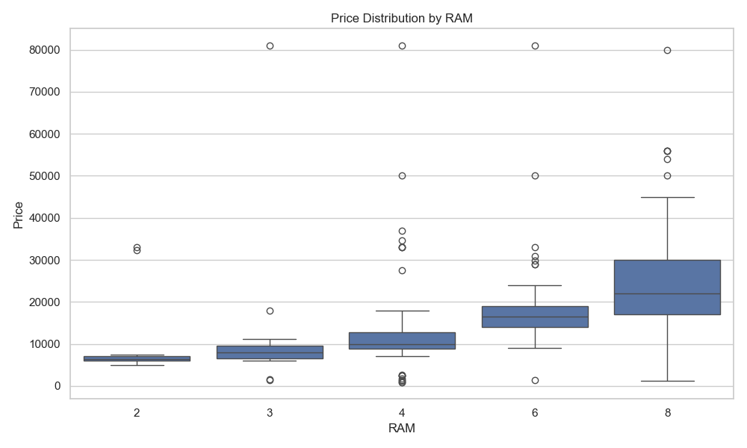
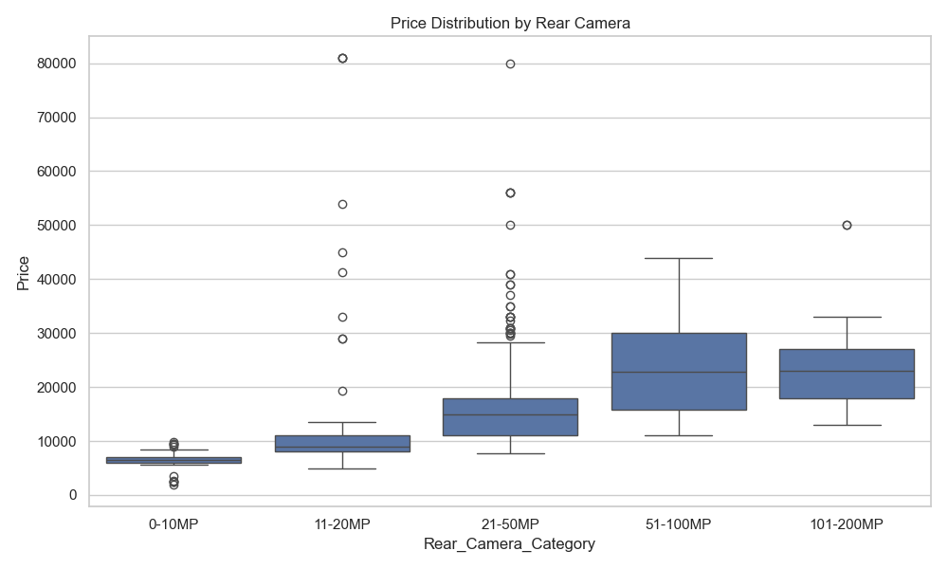
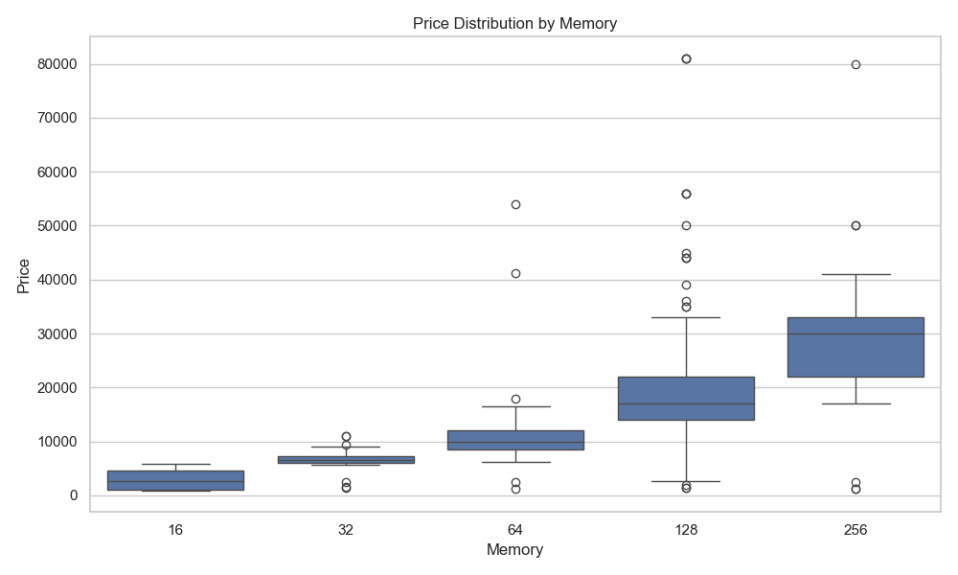

Slide 11
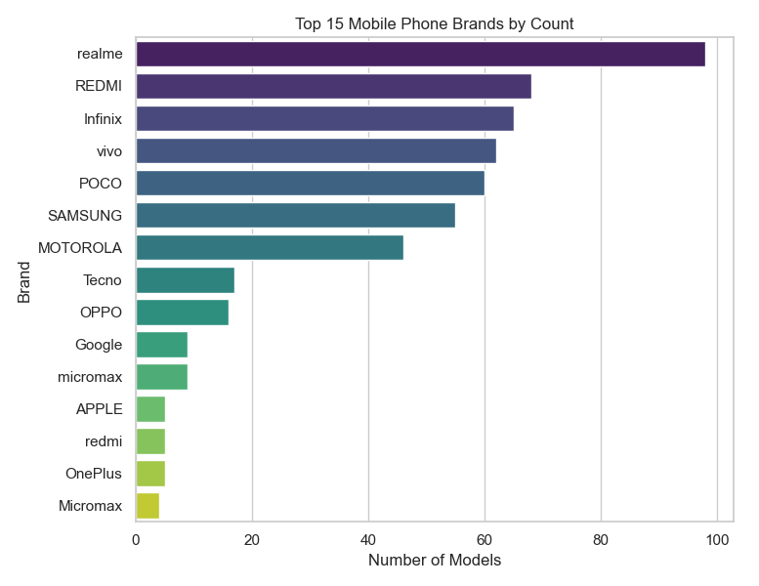
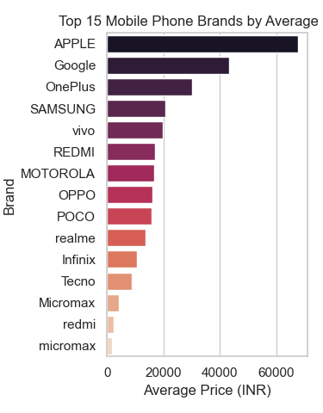

Slide 12




Marketing Recommendations
Highlight RAM & Memory
Strongest price correlation features.
Emphasize Camera Specs
Rear camera impacts pricing significantly.
Promote Battery Capacity
Focus on mid-range models.

Slide 13

Processor & Model Strategies
Target Premium Processors
Identify and market high-value processors.
Model-Specific Pricing
Use brand premium insights for pricing.

Slide 14

Summary of Model Insights
Random Forest Best Model
Camera & Memory Key
Brand & Processor Matter
Highest accuracy and fit.
Main drivers of price.
Influence targeted marketing and pricing.

Slide 15

Next Steps
Refine Marketing
Focus on RAM, memory, and camera features.
Adjust Pricing
Use model-specific and processor-based strategies.
Monitor Model
Update with new data for accuracy.

